Slide 1
Pre-quiz: Test Your Knowledge
OSHA has developed:
a. An in-depth JHA regulation
b. Guidelines for JHA
c. Nothing related to JHA
JHA helps to reduce workplace absences.
True
True or False?
The first step in JHA is to:
a. Break down the process
b. Identify the hazards
c. Determine safe procedures
Notes:
Slide Show Notes
Before we begin, let’s take a short pre-quiz to see how much you already know about job hazard analysis. See if you can answer these three questions correctly: Here are the answers.
OSHA has developed: b—Guidelines for JHA.
True—Job hazard analysis helps to reduce workplace absences.
The correct answer is: a—Break down the process.
How did you do? If you got them correct—congratulations, you are well on your way to learning about job hazard analysis! If you didn’t get all of them correct, don’t worry. We will be going over this information and much more during this session.

Slide 2
Regulatory Guidance
No specific JHA standard
OSHA provides JHA guidelines
OSHA inspectors may review hazard assessment program
JHAs are also called Job Safety Analysis (JSA) or Activity Hazard Analysis (AHA)
Notes:
2
Slide Show Notes
Although OSHA has no specific job hazard analysis standard, many OSHA standards require employers to conduct workplace hazard assessments so that proper precautions can be taken to protect you and your co-workers. One example is the PPE standard, which requires a hazard assessment to determine what type of PPE is required.
To help organizations conduct effective hazard assessments, OSHA has developed guidelines on process hazard analysis. Since OSHA only provides guidelines, we can’t be cited for not following them. However, in fact, our process hazard analysis program does follow these guidelines because they help us comply with OSHA standards generally and because they help us prevent workplace accidents, injuries, and illness.
And even though OSHA doesn’t require JHA, if we were ever inspected by OSHA, the inspector would very likely want to see our hazard assessment program. So we want to be sure we analyze process hazards accurately and frequently throughout our facility.
One final introductory point. Throughout this session, we’re going to use the term job hazard analysis, or JHA for short. But you may have also heard this type of hazard analysis referred to as Job Safety Analysis (JSA) or Activity Hazard Analysis (AHA). All of these terms refer to basically the same process.

Slide 3
What is a JHA?
Method of identifying hazards
Means of breaking the process down into steps
System for easily understanding hazards
Notes:
3
Slide Show Notes
What is job hazard analysis? It is a method of identifying the risks and hazards associated with each process we perform. If we don’t identify all of them, we can’t take corrective action to prevent accidents and injuries. So JHA is really essential to your safety and health on the job.
JHA also helps us break a process down into simple individual steps, allowing us to pinpoint all the risks and hazards associated with each step. If you look at an operation as a whole, you might see five or six risks or hazards. But when you break the operation down into simple discrete steps, you might realize that there are five or six risks or hazards associated with each step in the operation.
As you can already see, JHAs provide a system for easily understanding process hazards or risks. So it’s very important for you to understand what job hazard analysis is and how it works. And that’s what this training session is all about. So please pay careful attention.

Slide 4
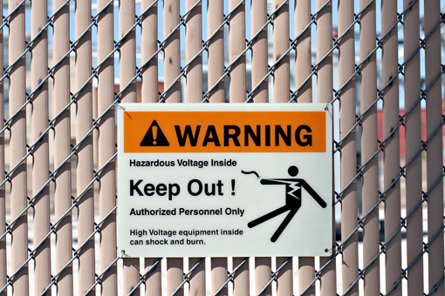
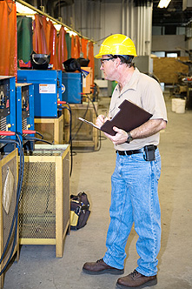
Why Perform JHAs?
Identify existing hazards
Identify potential hazards
Prioritize corrective actions
Reduce or eliminate hazards
Notes:
4
Slide Show Notes
Why perform job hazard analysis? Well, we’ve already partly answered that question. But let’s look more closely.
JHAs not only help us identify existing hazards or risks associated with each step in a process, but
It also helps us identify potential hazards or risks. Some are not as evident until you break the process down into simple discrete steps and examine each individual step in the operation.
JHA also helps us prioritize corrective actions. It tells us where to focus our time, energy, and resources so that we can deal with the most serious hazards first, the ones that can cause the most severe injuries or present the greatest risk of serious health problems. Not that all hazards and risks aren’t important. But we need an organized, prioritized way of going about dealing with workplace hazards.
When a JHA is properly conducted, we are able to reduce, control, or eliminate workplace hazards or risks. And that’s the real answer to the question, why perform JHAs? Because if we reduce or eliminate hazards, we reduce or eliminate the risk of accidents, injuries, and process-related illness.
Are you familiar with our JHA policy and the reasons we perform JHAs in our facility? Everyone should be.
Review your organization’s JHA policy, highlighting the reasons you perform JHAs and what you hope to achieve through JHA.

Slide 5
What Are the Benefits of JHAs?
Improves safety performance
Reduces absences
Increases productivity
Improves morale
Assists in OSHA compliance
Notes:
5
Slide Show Notes
JHAs have many benefits for you and for the organization as a whole.
The main benefit of course is that JHAs reduce accidents, injuries, and illness, thereby improving safety performance.
Because JHA reduces injuries and illness, it also reduces absences. This means we have more fully qualified people on the job every day, which means you don’t have to do extra work to cover for sick or injured co-workers. And it also means that each one of us is safer on the job. When we’re fully staffed, people aren’t stressed or overburdened, which means they can take their time and work safely.
More people at work every day means increased productivity as well. It means we’re able to meet production schedules and keep our organization operating at peak performance.
JHAs also help improve workplace morale. When people feel safe in the workplace, they’re happier and more satisfied with their job. And that means we can all do our best and contribute to the success of the organization.
Another very important aspect of JHAs is that it helps us comply with OSHA and similar workplace regulations. When we know about all the hazards, we can take the necessary steps to protect everyone as the regulations require.

Slide 6
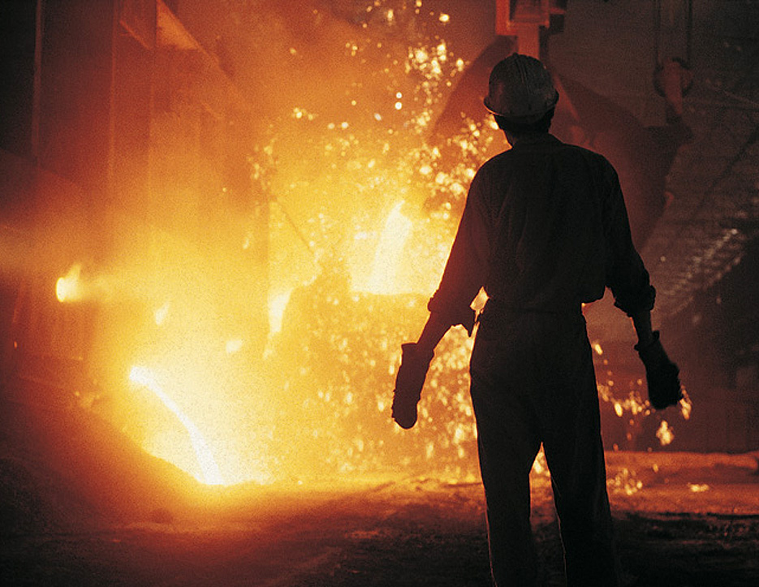
How Are Processes Selected for JHAs?
High mishap, injury, or illness rates
Frequent near misses
Procedures, processes, or equipment changes
All other processes
Notes:
6
Slide Show Notes
Our next question is, How are process’ selected for JHA? That’s an important question because, as we said earlier, for JHA to be effective, we have to prioritize. We can’t analyze all process’ at once. So,
We start with process’ with high mishap, injury, or illness rates. Obviously, those are the process’ with the most serious safety and health risks, and we need to address those problems first.
Also high on the list for JHAs are process’ where there have been a lot of near misses. Maybe nobody has been hurt so far, but these are mishaps waiting to happen, and we want to correct the problem before somebody does get hurt.
Jobs with procedure, process, or equipment changes are also high-priority targets for JHAs. Any of these changes can result in new, unanticipated hazards or risks. Or they may reduce, control, or eliminate them. Either way, we need to know.
After we’ve analyzed the process where mishaps are most likely to occur, we work our way down through less hazardous processes until we’ve made sure that through JHAs, we’ve come to understand all the hazards and risks associated with every process in the workplace.
Of course, since things are always changing, the process is never done. JHAs are an ongoing process.

Slide 7
Who Is Involved the JHA Process?
Safety personnel
Department managers and supervisors
Employees who perform the process
Design engineers
Maintenance personnel
Notes:
7
Slide Show Notes
To be successful, JHAs must be a total team effort that involves nearly everyone in the workplace. Generally speaking, the following people are involved in each job hazard analysis we conduct:
Safety personnel who are trained to identify hazards and know regulatory requirements;
Department managers and supervisors who know production processes and schedules and have the authority to implement changes;
Employees who perform the process and know them well;
Design engineers who design the operation and help “design out” identified hazards; and
Maintenance personnel who work on the equipment and are familiar with potential failure or risk scenarios in the work areas.
If you’ve been involved in a JHA, you may remember all the different people who participated. Think about the information you have about your process that you can contribute to the next JHA.
Identify the people involved in the JHA for the process performed by trainees, and discuss the need for cooperation and communication among all these people.

Slide 8
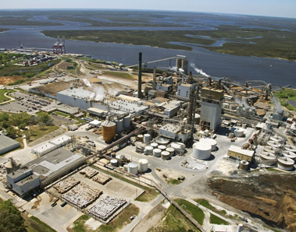
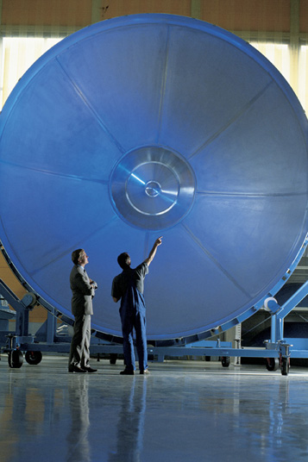
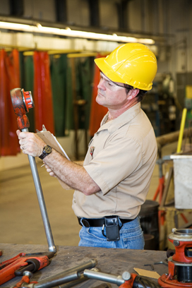
How Are Hazards Identified?
General inspections
Special inspections
Walk-around inspections
Safety Investigations
Notes:
8
Slide Show Notes
The next question we need to ask about job hazard analysis is, how are hazards and risks identified? There are several different ways.
General inspections can be performed by a number of different people. But most often they are conducted by safety professionals who are familiar with workplace hazards and risks and understand the regulatory requirements. General inspections usually involve a review of the entire facility from wall to wall. They are very comprehensive and also very time-consuming, so they are performed only once or twice a year.
Special inspections focus on areas where safety and health concerns or risks have been discovered. Special inspections are targeted, and investigate only certain operations. Safety personnel along with managers, supervisors, and employees involved in these operations usually work together to conduct special inspections. We might even call in outside experts to help us.
Walk-around inspections are usually conducted within a department on a routine basis—daily, weekly, or monthly. Supervisors are generally responsible for these inspections or the work areas they supervise. They report any possible concerns they find to safety personnel. During safety investigations, JHAs may be utilized to pin point where a failure in the process occurred and how it may be prevented in the near future.

Slide 9
What Are OSHA’s Inspections Guidelines?
List departments and operations involved
List operational activities
Assign inspection dates and duties
Determine sequence of activities and route
Identify follow-up responsibilities
List departments and operations involved
List operational activities
Assign inspection dates and duties
Determine sequence of activities and route
Identify follow-up responsibilities
Notes:
9
Slide Show Notes
OSHA offers us guidance through it’s JHA guidelines about what, when, and how to inspect the workplace and document our findings. For example, OSHA’s JHA guidelines recommend:
Listing departments and operations involved in different kinds of workplace safety inspections;
Listing and describing operational activities in areas being inspected;
Assigning inspection dates and duties;
Determining the sequence of inspection activities and the route of the inspection; and
Identifying and describing follow-up responsibilities resulting from inspections.

Slide 10
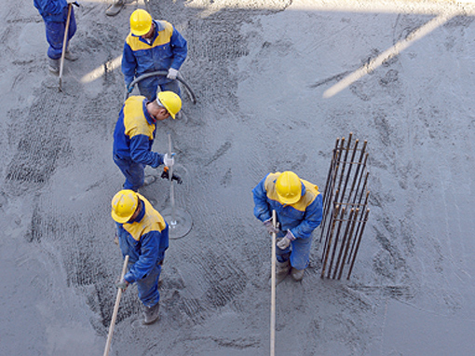
What’s the Function of Area Hazard Checklists?
Equipment
Procedures
Personnel
Notes:
10
Slide Show Notes
To assist in inspections and to facilitate the identification of workplace hazards we use area hazard checklists. These checklists help us evaluate:
Equipment
Procedures
Personnel
Are you familiar with the area hazard checklists we use in job hazard analysis? If not, ask your supervisor or the safety representative if you can see the checklist for your work area.
Bring samples of area hazard checklists used by your organization to the session and review them with trainees.

Slide 11
Which Elements of a Process Are Analyzed?
Preparation
Start-up
Operation
Shutdown
Maintenance
Notes:
11
Slide Show Notes
During JHA inspections the people conducting the inspection will be looking closely at all the discrete elements involved in an operation or process from start to finish. In other words, they’ll be watching the following actions closely:
Preparation prior to start-up;
Start-up;
Activities that take place during the operation or process;
Shutdown; and
Maintenance.
All of the elements must be analyzed because there may be—and usually are—hazards and risks associated with all of them.

Slide 12
JHA Explained: True or False?
JHAs look at the workplace as a whole.
We perform JHAs because OSHA’s JHA standards require it.
Routine safety inspections provide valuable information for JHAs.
Only safety personnel are involved in the JHA process.
Notes:
12
Slide Show Notes
OK, now let’s see how much you remember about the information presented in the previous slides. Decide whether the statements on the screen are true or false. Let’s begin.
JHAs looks at the workplace as a whole. True or false? The correct answer is false. JHAs look at individual processes and examine each discrete step involved in performing the process.
We perform JHAs because OSHA’s JHA standards requires it. True or false? The correct answer is false. OSHA doesn’t have a specific standard requiring us to perform JHAs. It does offer guidelines however, which we follow to make processes safer.
Routine safety inspections provide valuable information for JHAs. True or false? The correct answer is true. Whether they are facility-wide inspections, special targeted inspections to examine certain safety and health risks, or daily walk-around inspections, inspections contribute a lot of essential information for JHAs.
And finally, only safety personnel are involved in the JHA process. True or false? The correct answer is false. Managers, supervisors, and employees also play a very important role.

Slide 13
JHA Explained
Do you understand:
What the term “JHA” means?
Purpose of JHAs?
Benefits of conducting JHAs?
How processes are selected and who participates in JHAs?
Inspections to identify hazards?
Notes:
13
Slide Show Notes
Now it’s time to ask yourself if you understand all the information about JHAs presented in the previous slides. For example, do you understand what we’ve said about:
What the term “JHA” means?
The purpose of JHAs?
The benefits of conducting JHAs?
How processes are selected for JHAs and who participates in the process?
Inspections to identify hazards and risks?
You need to understand all this information in order to fully understand the importance of JHAs in your facility.
Let’s continue to the next slide now and identify the steps in the JHA process.

Slide 14
Steps in the JHA Process
Break down the process
Identify the hazards
Evaluate the hazards
Determine safe procedures and protective measures, and revising the JHAs
Notes:
Slide Show Notes
The first step in process hazard analysis is to break the process down into all the simple, discrete tasks that make up the process. This allows you to look at all the hazards involved in performing the process—including hidden hazards and risks.
Step two is to identify the hazards involved in each task that must be performed to complete the process. Depending on the process, you could end up with a long or short list. Some hazards and risks may be repeated in several or all the tasks that make up the process.
Step three involves evaluating each hazard so that you can determine what to do about it and how to prevent injuries or work-related illness.
Step four is to determine safe procedures and protective measures to prevent accidents, injuries, and illness as a result of each hazard or risk.
And finally, step five has to be done if the current JHA has become outdated because of changes in the process. A JHA might also have to be revised if hazards are eliminated, reduced, or controlled thanks to the previous hazard analysis.
Now let’s continue to the next set of slides and examine each of these steps in more detail, beginning with the breakdown of the process.

Slide 15
Break Down the Process
STEP 1
List each task in order of occurrence
Describe each action
Consider the conditions
Think about safety issues
Notes:
Slide Show Notes
To break down the process for a JHA, you have to:
List each discrete task in the order it’s performed;
Describe each action involved in performing each task;
Consider the conditions under which the process is performed; and
Think about the safety issues involved at each step in the process.

Slide 16
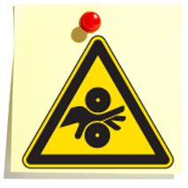
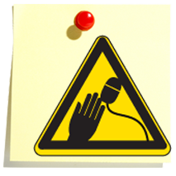
Identify the Hazards
STEP 2
Impact
Penetration
Being caught between pinch points
Harmful airborne contaminants (Respiratory Hazards)
Repetitive motions and awkward postures (Ergonomics)
Noise
Notes:
Slide Show Notes
Next you have to identify all the hazards and risks associated with each of the tasks you’ve listed in step one. These may include:
Impact, such as from being struck by an object or falling and hitting the ground;
Penetration by sharp or pointed objects that cause cuts or punctures;
Being caught between two objects or pinch points, which can cause crushing or amputations;
Harmful airborne contaminants from solids, liquids, and gases;
Repetitive motions and awkward postures, which can cause musculoskeletal disorders, or MSDs; and
Noise hazards associated with equipment, etc…

Slide 17
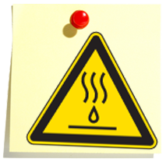
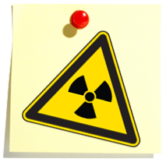
Identify the Hazards (cont.)
STEP 2
Heat/cold (Exposure)
Compression
Optical radiation
Chemical exposures
Ionizing radiation
Slippery surfaces
Notes:
Slide Show Notes
Hazards associated with various tasks might also include:
Heat or cold;
Compression, which can cause broken bones, amputations, and other serious bodily damage;
Optical radiation, which can cause serious eye damage and even blindness;
Chemical exposures, such as getting chemicals on the skin or in the eyes or accidentally swallowing hazardous chemicals;
Ionizing radiation, which includes the risk of being exposed to radioactive material; and
Slippery surfaces which can cause injuries from falls.
Think about the various hazards associated with the different tasks involved in the process you perform.

Slide 18
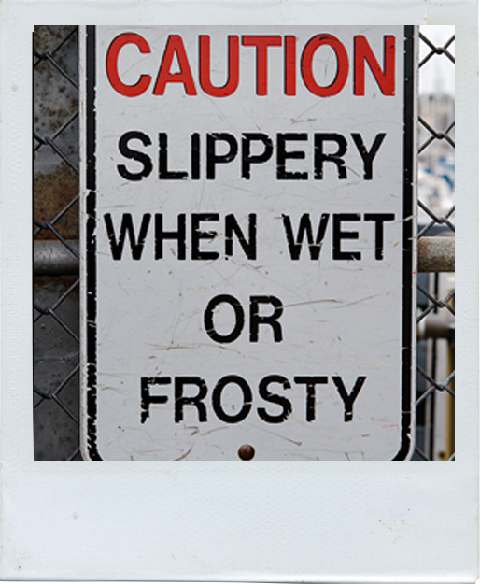
Evaluate the Hazards
STEP 3
Is this a safety or health hazard?
Could the hazard cause an injury or illness?
How serious is the risk?
Is this hazard always present?
Notes:
Slide Show Notes
Step three is to evaluate the process hazards you’ve identified in the previous step. When evaluating hazards, you have to ask questions like:
Is this a safety or health hazard?
Could this hazard cause an injury or illness?
How serious is the risk?
Is this hazard always present when the process is being performed or is it an intermittent hazard?

Slide 19
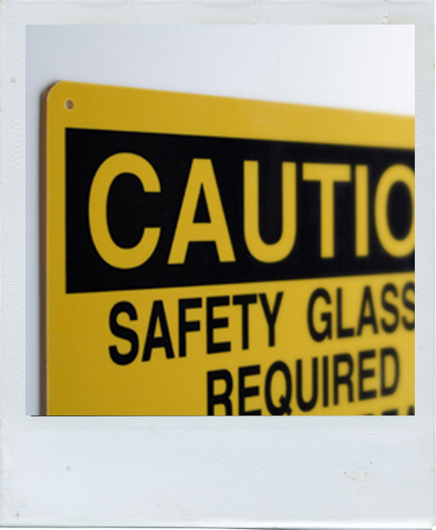
Evaluate the Hazards (cont.)
STEP 3
Are engineering and administrative controls effective?
Is the correct PPE being utilized?
Is safety training creating sufficient awareness?
Are protective measures adequate?
Notes:
Slide Show Notes
The third step is to evaluate the hazards. To do that, ask the following questions:
Are the engineering and/or administrative controls currently being used to prevent injuries and illnesses effective?
Is the correct Personal Protective Equipment (PPE) being utilized to protect employees against hazards?
Is safety training creating sufficient awareness of the hazards and knowledge of the precautions that must be taken to prevent accidents?
Are the protective measures currently in place adequate, or are additional or different measures required to ensure safety?
Can you think of some other useful questions that would help evaluate hazards identified by a JHA?

Slide 20
Determine Safe Procedures and Protections
STEP 4
Perform the process differently
Reconfigure work area/ workstations
Substitute less hazardous materials and chemicals
Change from manual to mechanical
Insulating or cleaning
Notes:
Slide Show Notes
The fourth step in the JHA process is to determine safe procedures and protective measures to prevent injuries and illness based on the hazards identified and evaluated in previous steps. Common ways to reduce or eliminate hazards revealed by a JHA include:
Performing the process differently;
Reconfiguring the work area or workstations to make them safer;
Substituting less hazardous materials and chemicals;
Changing from manual to mechanical techniques to reduce the exertion required to perform the process and prevent stress and strain injuries; and
Insulating or cleaning surfaces.

Slide 21
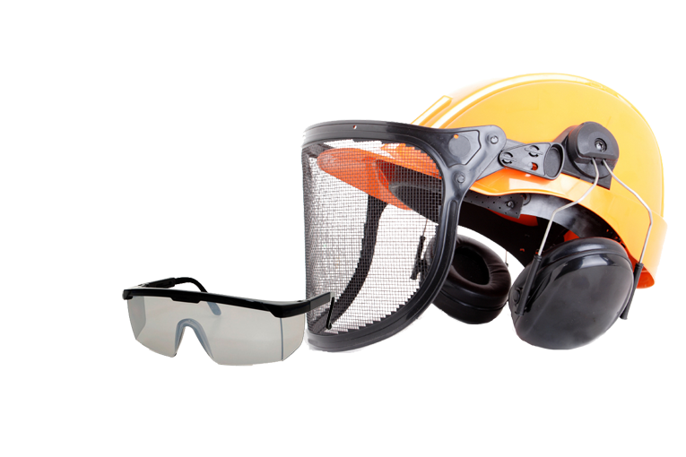
Determine Safe Procedures and Protections (cont.)
STEP 4
Add, improve, change safety training
Change tools or equipment
Change or add PPE
Perform certain tasks less often
Notes:
Slide Show Notes
Other ways to deal with process hazards include:
Adding, improving, or changing safety training;
Changing tools or equipment;
Changing or adding PPE; and
Performing the most hazardous tasks less frequently.
Think about changes in procedures and protective measures that can result from JHAs, and how those changes can help make your job safer. Can you think of other steps we might take as a result of a JHA to make your job safer?

Slide 22
Revise the JHA:
STEP 4
When a mishap, injury, or work-related illness occurs
After a near miss
When the process changes
Following an employee’s safety complaint
When equipment is damaged
Per scheduled review
Notes:
Slide Show Notes
A Job Hazard Analysis may require the process to be reviewed and revised any time one of the items listed on the screen occurs. For example, a JHA will be reviewed and may be revised:
When a mishap, injury, or work-related illness occurs;
After a near miss;
When the process changes, introducing the possibility of new or different hazards;
Following an employee’s safety complaint;
When equipment is damaged; or
According to a scheduled, routine review, such as once every 6 or 12 months.
Perhaps you can think of some examples of when a JHA has been revised.

Slide 23
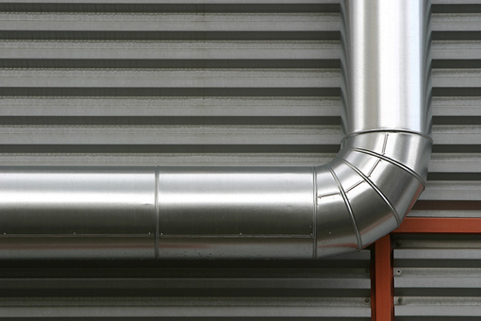
Control Method Hierarchy
Engineering Controls
Administrative Controls
Personal Protective Equipment (PPE)
Notes:
23
Slide Show Notes
In general, when taking steps to deal with process hazards, we follow a control method hierarchy recommended by OSHA.
We begin by implementing engineering controls to eliminate or reduce the hazards and risks. Ventilation and machine guarding are good examples of engineering controls.
If engineering controls alone can’t eliminate the hazards or risks, or can’t effectively be used, we next rely on administrative controls such as training, safe work practices, job rotation, and so on to reduce the risk of exposure.
Finally, if engineering and administrative controls can’t completely ensure your safety, you need to wear appropriate Personal Protective Equipment (PPE) to provide a personal barrier between you and the hazards you face when you perform your job.

Slide 24
JHA Steps
Do you understand:
How to break down a process for a JHA?
How to identify hazards?
How to evaluate hazards?
How to determine safe procedures and protections?
When a JHA should be revised?
Notes:
24
Slide Show Notes
Let’s take some time now to make sure you understand the information presented in the previous slides about the JHA process. Do you understand:
How to break down a process for a JHA?
How to identify hazards in each step of a process?
How to evaluate hazards identified?
How to determine safe procedures and protections?
When a JHA should be revised?
It’s important to understand the process so that you can contribute to the success of any JHA in which you’re involved.
Now let’s conclude the session with some key points to remember.

Slide 25
JHAs are an essential part of any effective safety program
You should be familiar with JHAs
Your participation in the JHA process is very important
Notes:
25
Slide Show Notes
Here are the main points to remember from this session on Job Hazard Analysis:
JHAs are an essential part of any effective safety program.
You should be familiar with the purpose and process of JHAs.
Your participation in the JHA process is very important and can help keep you and your co-workers safer on the job.
This concludes the Job Hazard Analysis training program.

