Slide 1
Notes:
In 1983, OSHA created the Hazard Communication Standard to ensure that employers inform their employees about the hazardous chemicals in their workplace.

Slide 2
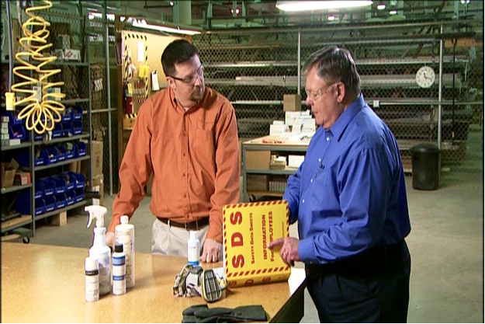
HazCom and GHS
OSHA created the Hazard Communication Standard in 1983.
Ensures that employers inform employees about hazardous chemicals.

Slide 3
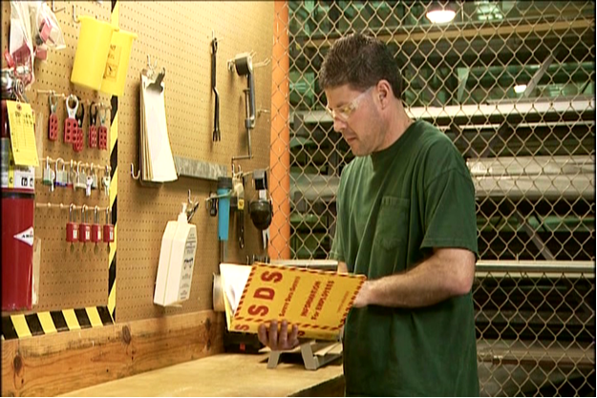
Your Right To Know!
This regulation gives you the right to know:
Chemicals that are used in the workplace
Possible dangers you are being exposed to
How to protect yourself and others
Notes:
Commonly referred to as HazCom, or the Right to Know Law, this regulation gives you the right to know which chemicals are being used in your workplace, the possible dangers you are being exposed to, and how you can protect yourself when using hazardous chemicals.

Slide 4
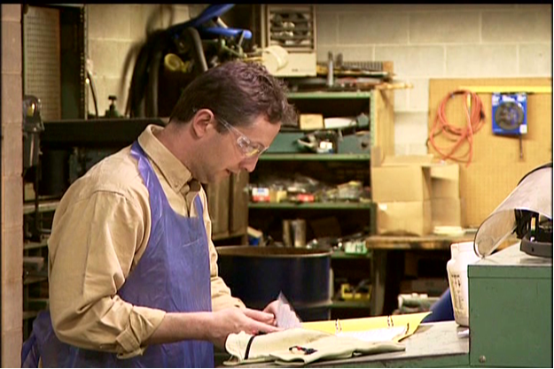
The “Old” HazCom Standard
Material safety data sheets and labels were:
Inconsistent
Incomplete
Difficult to read
Notes:
Chemical safety begins with chemical manufacturers who classify and categorize a chemical based on its hazards. According to OSHA, the “old” HazCom Standard gave chemical manufacturers too much flexibility in drafting chemical labels and material safety data sheets for chemicals, and the results were inconsistent, incomplete and difficult-to-read materials for employees.

Slide 5
HazCom and GHS
In 2012, OSHA aligned the HazCom Standard with the United Nation’s Globally Harmonized System (GHS).
Notes:
In 2012, OSHA aligned the HazCom Standard with the United Nation’s Globally Harmonized System, more commonly known as GHS.

Slide 6
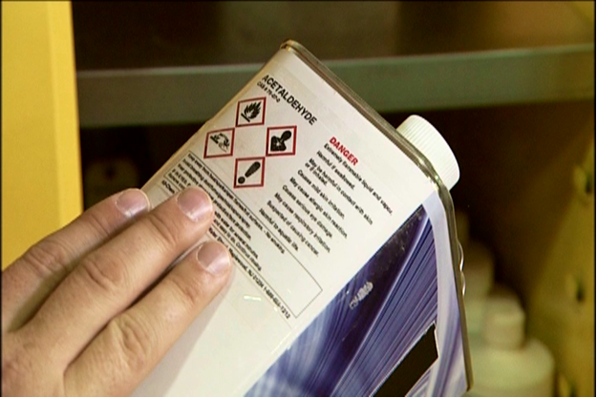
HazCom and GHS
OSHA adopted the GHS:
Hazard definitions
Safety data sheet format
Labeling format
Notes:
While OSHA maintained the framework of its traditional HazCom Standard, it adopted the GHS hazard definitions and safety data sheet and labeling formats.

Slide 7
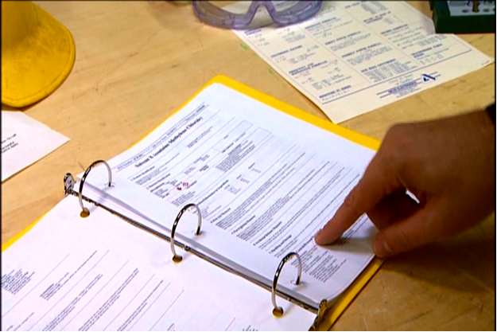
The Revised HazCom Standard
The revised Standard:
Chemical manufacturers create GHS-style safety data sheets (SDSs) and labels for each chemical it produces.
SDSs and labels are built using consistent and easily understood elements.
Notes:
The “new” HazCom Standard calls for chemical manufacturers to create a GHS-style safety data sheet and label for each chemical it produces. The safety data sheets and labels are “built” using consistent and easy-to-understand elements.

Slide 8
Win-Win!
Per OSHA, there will be:
Less confusion
Fewer fatalities
Fewer injuries and illnesses
Greater ability to compete in the global market
Notes:
According to OSHA, the new rule will be a win-win for chemical manufacturers, employers and employees because there will be less confusion, fewer fatalities, injuries and illnesses, and a greater ability to compete in the global market.

Slide 9
Major Changes
Revised criteria for classification of hazards
Revised labeling provisions that include requirements for standardized:
Signal words
Pictograms
Hazard statements
Precautionary statements
Notes:
Major changes to the HazCom Standard include:
- Revised criteria for classification of chemical hazards; and
- Revised labeling provisions that include requirements for use of standardized signal words, pictograms, hazard statements and precautionary statements.

Slide 10
Major Changes, continued…
Specified format for safety data sheets (SDSs)
Related revisions to definitions
Requirements for employee training on safety data sheets and labels
Notes:
Other major changes include:
- A specified format for safety data sheets; and
- Related revisions to definitions and requirements for employee training on labels and safety data sheets.

Slide 11
Your Right to Understand
For almost 30 years, employees have had the right to know about chemical hazards in the workplace.
With the adoption of GHS, employees have the right to understand.
Notes:
For almost 30 years, employees have had the right to know about chemical hazards in the workplace; with the adoption of GHS, employees have the right to understand.

