Slide 1
Ergonomics Program

Slide 2
References
NAVMC DIR 5100.8, Chapter 19
OPNAVINST 5100.23G
NIOSH PUB. NO. 97-117
DODI 6055.1

Slide 3
Overview
ID Musculoskeletal Disorders
Apply Engineering Controls
Apply Administrative Controls
Reduce Musculoskeletal Disorders
Describe how to incorporate ergonomics into repair or replacement of tools, equipment or facilities

Slide 4
What is ERGONOMICS?
Matching the work place to the worker
OSHA enacted the Ergonomics Program
Why are we hearing about Ergonomics now
Notes:
The study of the design of work in
relation to the physiological and
psychological capabilities of people

Slide 5
Two Broad Categories of Workplace Disorders
Injuries:
  cut, crush, or fall
Illnesses:
  repeated exposure to various substances, hazards, or environmental conditions
Notes:
Disorders that occur due to a one-time event such as a cut, crush, or fall
Disorders related to repeated exposure to various substances, hazards, or environmental conditions

Slide 6
Scope of Ergonomic Illnesses
Cumulative trauma disorders (CTDs)
  Repeated biomechanical stress
  Damage to the tendons, tendon sheaths, related bones, muscles, and nerves of:
    Hands, wrists, elbows, shoulders, neck, back.
Notes:
CTD are health disorders arising from damage to the tendons, tendon sheaths, related bones, muscles, and nerves of: Hands, wrists, elbows, shoulders, neck, back.

Slide 7
Scope of Ergonomic Illnesses cont.
Musculoskeletal disorders (MSDs)
  Neck, back, shoulder, elbow, hand, wrist, and fingers
  Nerves, tendons, cartilage, ligaments, and muscles
  MSDs can happen to anyone
Notes:
Musculoskeletal disorders (MSDs) affect soft tissue of the body in areas like the neck, back, shoulder, elbow, hand, wrist, and fingers.
These include the nerves, tendons, cartilage, ligaments, and muscles.
MSDs can happen to anyone from office workers and industrial employees to athletes and hobbyists.

Slide 8
Scope of Ergonomic Illnesses cont.
Work-related musculoskeletal disorders (WMSDs)
  Caused by or made worse by the work environment
  Affect or reduce performance capabilities
Notes:
Work-related musculoskeletal disorders (WMSDs) are MSDs that are caused by or made worse by the work environment.
WMSDs harm or reduce performance capabilities often result from a mismatch between workers and the tasks required of them.

Slide 9
Frequently Occurring Occupationally Induced Disorders
Carpal Tunnel Syndrome
Tendonitis
Tenosynovitis
Synovitis
Stenosing Tenosynovitis of the fingers
Low back pain
Notes:
Tenosynovitis (inflammation of the tendon sheath)
Synovitis (inflammation of the lubricating fluid of the joints)
Stenosing Tenosynovitis of the fingers (inflammation of the tendon sheath)

Slide 10
Potential Indicators and Symptoms of CTDs
Trends in accidents and injuries
Incidents of CTD
Absenteeism
High turnover rate
Working conditions noted by people with disabilities
Notes:
Signs and Symptoms.
Painful aching joints, muscles
Pain, tingling or numbness
Fingers or toes turning white
Shooting or stabbing pains
Swelling or inflammation
Stiffness or difficulty moving
Burning sensation
Pain during the night

Slide 11
Potential Indicators and Symptoms of CTDs cont.
Complaints about musculoskeletal pain
High overtime and increased work rate
Manual material handling/repetitive motion task
Poor product quality
Notes:
Signs and Symptoms.
Painful aching joints, muscles
Pain, tingling or numbness
Fingers or toes turning white
Shooting or stabbing pains
Swelling or inflammation
Stiffness or difficulty moving
Burning sensation
Pain during the night

Slide 12
Risk Factors
Force: physical effort required to maintain control of equipment or tools
  perform heavy lifting, pushing, pulling, or carrying
Repetition: performing the same motion
  prolonged typing, assembling components, and repetitive hand tool usage
Notes:
Force: the amount of physical effort required to maintain control of equipment or tools, or to perform a task such as heavy lifting, pushing, pulling, or carrying
Repetition: performing the same motion or series of motions continually or frequently for an extended period of time with little variation such as prolonged typing, assembling components, and repetitive hand tool usage

Slide 13
Risk Factors cont.
Awkward postures: positions that significantly deviate from the neutral position
  working over-head, extended reaching, twisting, squatting, or kneeling
Static postures: holding a fixed position or posture
  gripping tools that can’t be set down
  standing in one place for prolonged periods
Notes:
Awkward postures: refers to positions of the body that significantly deviate from the neutral position while performing job tasks such as working over-head, extended reaching, twisting, squatting, or kneeling
Static postures: refer to holding a fixed position or posture such as gripping tools that can’t be set down, standing in one place for prolonged periods

Slide 14
Risk Factors cont.
Vibration: specific part of the body comes into contact with a vibrating
  chain saw, electric drill, chipping hammer, wood planer, punch press, or packing machine
Whole body vibration occurs when standing or sitting in vibrating environments
  driving a truck over bumpy roads or operating a jack hammer
Notes:
Vibration: localized vibration occurs when a specific part of the body comes into contact with a vibrating object such as a chain saw, electric drill, chipping hammer or equipment like a wood planer, punch press, or packing machine
Whole body vibration occurs when standing or sitting in vibrating environments like driving a truck over bumpy roads or when using heavy vibrating equipment that requires whole body involvement like operating a jack hammer

Slide 15
Risk Factors cont.
Contact stress: continuous contact between sensitive body tissues and hard or sharp objects
Notes:
Contact stress: results from occasional, repeated, or continuous contact between sensitive body tissues and hard or sharp objects like resting the wrist on the edge of a desk, or tool handles pressing into the palms

Slide 16

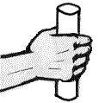
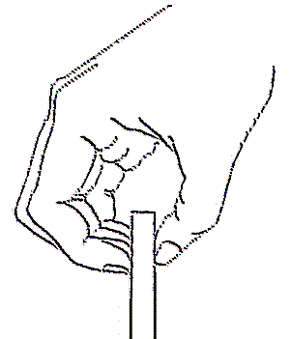
Hand Force
A power grip can be 5 times stronger than a pinch grip
Takes 4.6 lbs. of force
=
10 lbs.
2 lbs.

Slide 17
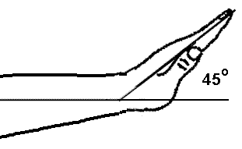
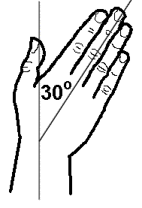
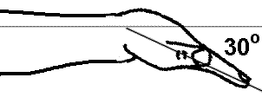

Wrist Bent
Extension
Ulnar deviation
Flexion

Slide 18
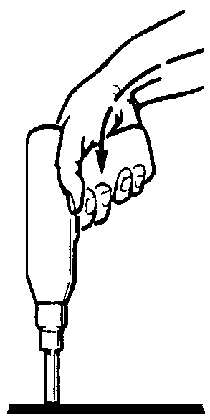
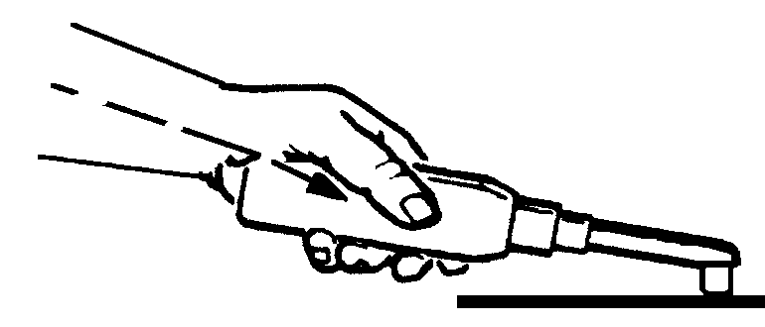
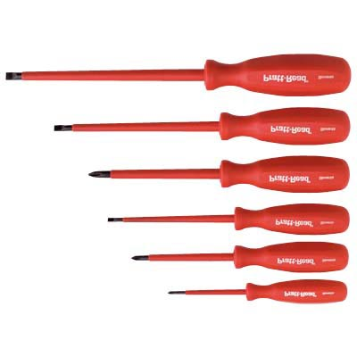
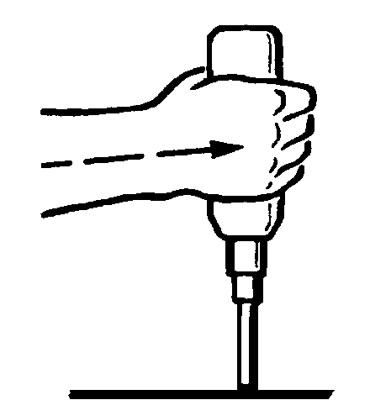
Tool Use
Working with bent wrists decreases grip strength
Handles get smaller, but hand does not
Use tools that let you keep your wrist straight

Slide 19
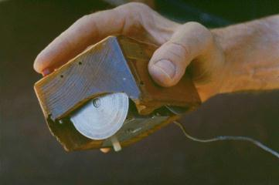
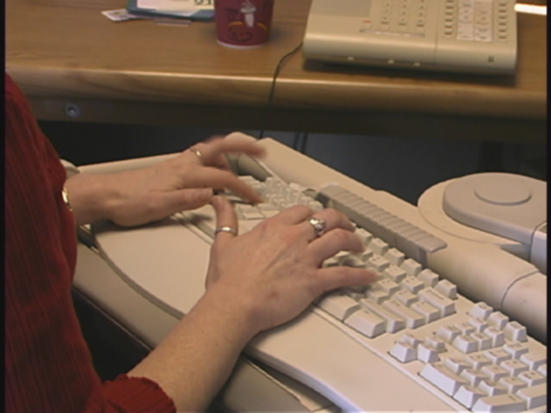
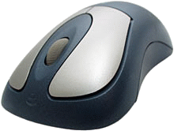
Intensive Typing
The Prototype

Slide 20
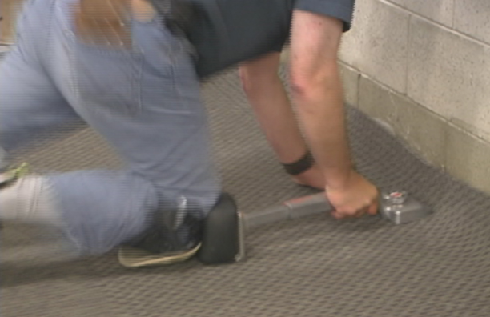
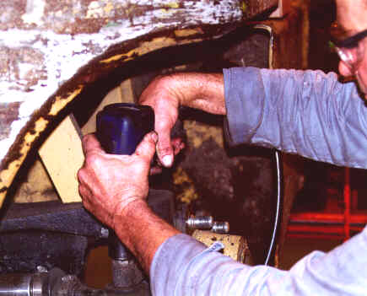

Repeated Impacts

Slide 21
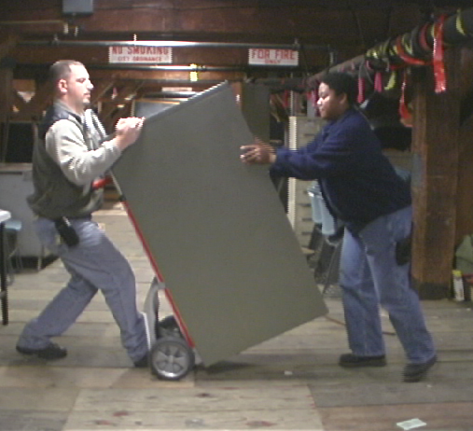
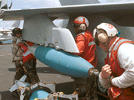
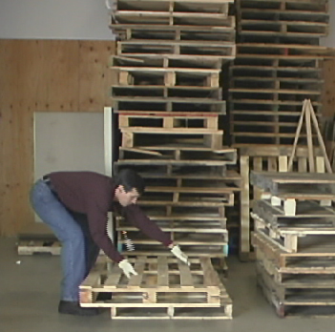
Frequent, Awkward, or Heavy Lifting

Slide 22
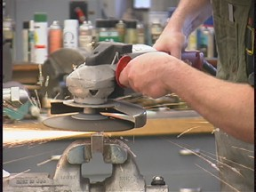
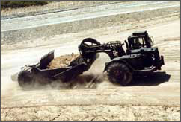

Vibration

Slide 23
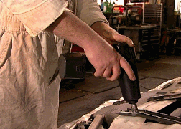
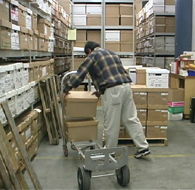
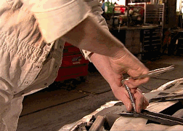
Repetitive Motion

Slide 24
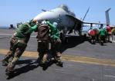
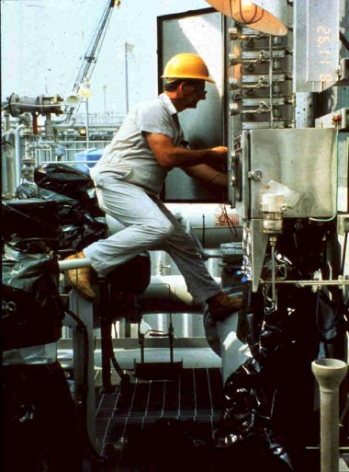
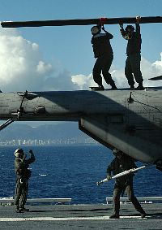
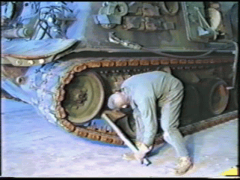
Awkward Positions

Slide 25
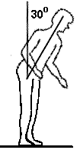

Back Bent More Than 30 Degrees

Slide 26
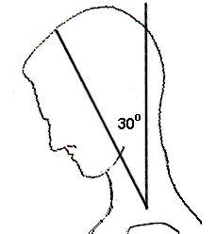
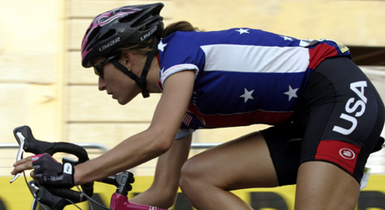

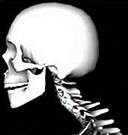
Neck Bent More
Than 30 degrees
Shortened muscles compress nerve

Slide 27
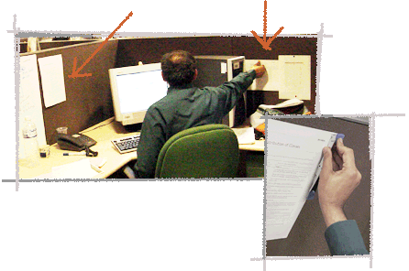
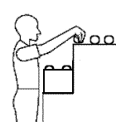
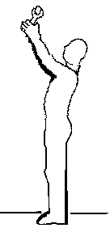

Hands Over Head or Elbows Above Shoulders

Slide 28
Recent History
WMSDs = half of all rated military disabilities
  one third reported civilian injuries and illnesses within the Marine Corps
Increase in reporting WMSDs
  Changes in work processes
  Increased awareness
Notes:
represent over half of all rated military disabilities and over one third of all reported civilian injuries and illnesses within the Marine Corps
WMSDs In recent years there has been an increase in reporting WMSDs for Marine Corps personnel which can be attributed to
-Changes in work processes and work center risks
-Advanced information technology and training have increased awareness

Slide 29
Management Commitment and Personnel Involvement
Partnership between all working levels is essential to prevent WMSDs
Command emphasis and management commitment
  Personnel involvement is essential
Notes:
A partnership between all working levels is essential to prevent WMSDs and reduce the risk in all workplaces
-Command emphasis and management commitment provide the organizational resources and motivation to implement a strong ergo program
-Personnel involvement is essential for identifying risks and developing effective abatement plans

Slide 30
Hazard Prevention and Control
Eliminate, reduce, or control the presence of risk factors
  Engineering controls
  Administrative controls
  PPE
    DOD does not recognize back belts or wrist splints as PPE
Notes:
DOD does not recognize back belts or wrist splints as PPE… they are considered medical appliances

Slide 31
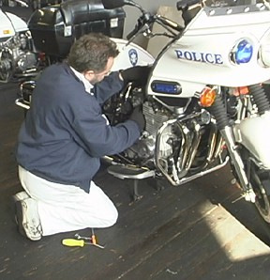
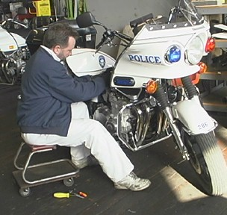
Engineering Controls
Preferred mechanism for controlling ergonomic hazards
Redesigning the work station, work methods, and tools
Notes:
Engineering controls or techniques are the preferred mechanism for controlling ergonomic hazards
This may entail redesigning the work station, work methods, and tools to reduce the demands of the job, such as exertion, repetition, and awkward positions

Slide 32
Administrative Controls
Rotating personnel to jobs with dissimilar physical requirements
Establishing work/rest schedules
Training personnel to use appropriate work methods
Notes:
Training personnel to use appropriate work methods when engineering controls are not feasible

Slide 33
Work Station Design
Workstations must be easily adjustable to accommodate the worker performing the task

Slide 34
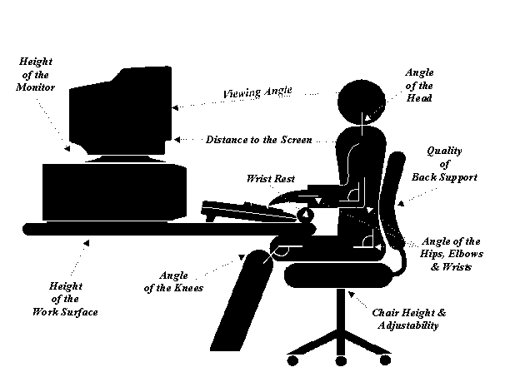

Slide 35
Training
Provided to all Marine Corps personnel
Recognize risk factors and understand procedures used to minimize the risks
Refresher training will be provided annually or if new risks are discovered
Notes:
Ergonomics training will be provided to all Marine Corps personnel
Training should enable each person to recognize risk factors and understand procedures used to minimize the risks
Refresher training will be provided annually and retraining will be done when personnel are assigned to a new job with different risks, or new risks are discovered

Slide 36
Training Elements
Ergonomic definitions and concepts
Contributing physical risk factors and personal trait
How to recognize and report early warning signs and symptoms of WMSDs

Slide 37
Training Elements cont.
How to prevent WMSDs by recognizing risk factors and basic elements of effective design
Wellness and Semper Fit Programs

Slide 38
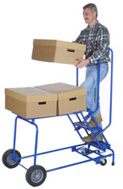
Back Injury Training
Anatomy and physiology
Biomechanics of lifting
Weight control
How to avoid back injuries
Physical fitness
Notes:
Anatomy and physiology to explain how the back works

Slide 39
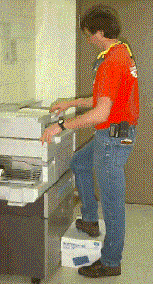
Standing Posture
Keep your spinal column aligned in its natural curves
Prop one foot up on a stool
Notes:
Keep your spinal column aligned in its natural curves
Prop one foot up on a stool to reduce stress in your lower back

Slide 40
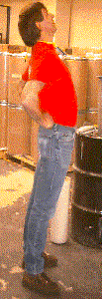
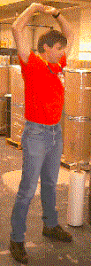
Shift and Stretch
Shift your posture often
Stretch frequently
Keep your body flexible (not rigid or fixed)
Don’t force your body to conform to its workspace
Notes:
Stretch frequently throughout the day

Slide 41
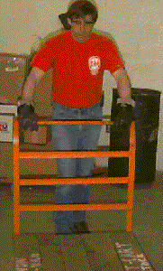
Push not Pull
Can you slide it instead of lifting it

Slide 42
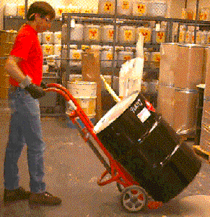
Use Lifting Devices
Use proper equipment
  Hand trucks
  Forklifts
  Dollies
  Use gloves if needed

Slide 43
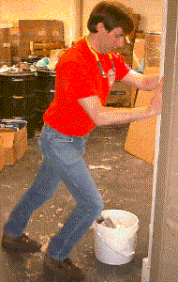
Stretch and be Ready
Stretch your muscles or warm up before lifting
Slip resistant shoes
Clear a pathway before you move the item

Slide 44
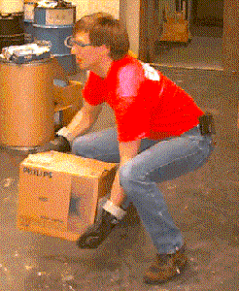
Lift with Your Legs
Plant your feet firmly - get a stable base
Bend at your knees - not your waist
Tighten your abdominal muscles to support your spine

Slide 45
Lift with Your Legs cont.
Get a good grip - use both hands
Keep the load close to your body
Use your leg muscles as you lift
Keep your back upright, keep it in its natural posture
Lift steadily and smoothly without jerking
Notes:
Remind students of the 2-man lift rule

Slide 46
Supervisors Responsibilities
Ensure personnel receive training
Identify and report potential risk factors
Request assistance for managing risk factors
Notes:
Assist the Ergonomics Coordinator in implementing the ergonomic plan

Slide 47
Installation safety office Responsibilities
Develop and implement an ergonomics program
Provide training and support to tenant commands

Slide 48


