Slide 2
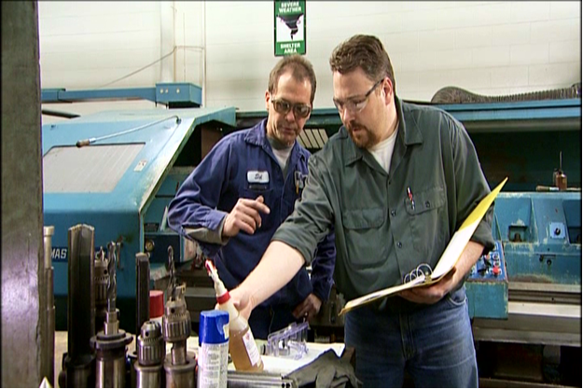
The HazCom Standard
Gives you the right to know about:
Chemicals that are used in your workplace
Possible dangers you could be exposed to
How to protect yourself and others
Notes:
The Occupational Safety and Health Administration, or OSHA, developed the Hazard Communication Standard to help protect employees from the dangers of hazardous chemicals. Commonly known as HazCom, or the “Right to Know” law, this regulation gives you the right to know which chemicals are being used in your workplace, the possible dangers you could be exposed to, and how to protect yourself and others when using hazardous chemicals.

Slide 3
Hazardous Chemical
A hazardous chemical is any chemical which is classified as a:
Physical hazard
Health hazard
Simple asphyxiant
Combustible dust
Pyrophoric gas
Hazard not otherwise classified
Notes:
So, what makes a chemical hazardous? A hazardous chemical is any chemical which is classified as a:
- Physical hazard or a health hazard;
- Simple asphyxiant;
- Combustible dust;
- Pyrophoric gas; or
- Hazard not otherwise classified.

Slide 4
Physical Hazards
Physical hazards are chemicals that can cause:
Fire
Explosion
Violent reaction
Notes:
Physical hazards are chemicals that can cause a fire, explosion or some other violent reaction when they come in contact with air, water or other chemicals.

Slide 5
Health Hazards
Health hazards are chemicals that are harmful to your health and can cause:
Short-term (acute) health problems
Long term (chronic) health problems
Notes:
Chemicals that are harmful to people’s health are called health hazards. By entering the body in one of three ways - inhalation, skin contact or ingestion - these chemicals can cause short-term (acute) health problems or long-term (chronic) health problems.

Slide 6
Health Hazards, continued…
OSHA considers a health hazard to be any chemical which:
Is toxic
Is corrosive to the skin or eyes
Is a respiratory sensitizer
May cause cancer, birth defects or reproductive issues
Attacks specific organs
Is harmful or deadly when inhaled
Notes:
OSHA considers a health hazard to be any chemical which:
- Is toxic;
- Is corrosive to the skin or eyes;
- Is a respiratory sensitizer;
- May cause cancer, birth defects or reproductive issues;
- Attacks specific organs in the body; or
- Is harmful or deadly when inhaled.

Slide 7
Five Employer Requirements
1. Create a hazardous chemical inventory
2. Ensure each chemical has a GHS-style safety data sheet
3. Ensure each chemical container is properly labeled
4. Create and implement an employee training program
5. Develop a written HazCom program
Notes:
Given that hazardous chemicals can be very dangerous, the HazCom Standard mandates that your employer comply with five regulatory requirements, all to help keep you safe:
1. Identify and create an inventory of all hazardous chemicals at the workplace.
2. Ensure each chemical has a GHS-style safety data sheet, or SDS, that is easily accessible to all employees who work with that chemical.
3. Ensure each chemical container is properly labeled with a GHS-style label or an OSHA-approved workplace label.
4. Create and implement an employee HazCom training program.
5. Develop a written HazCom program that describes how the HazCom program will be implemented and how your company will comply with the HazCom Standard.

Slide 8
The HazCom Chain
HazCom starts at the chemical manufacturing plant:
Chemists classify and categorize the chemical
Safety data sheets and labels are created
Safety data sheets and labels are passed along to each company and person who handles the chemical
Notes:
Hazard Communication begins at the chemical manufacturing plant. Chemists classify and categorize each chemical based on its hazards. From this information the chemical’s GHS-style safety data sheet and label are created.
These safety data sheets and labels must be passed along to each company and person who handles this chemical: from supplier, to transporter, to final end-user.

Slide 9
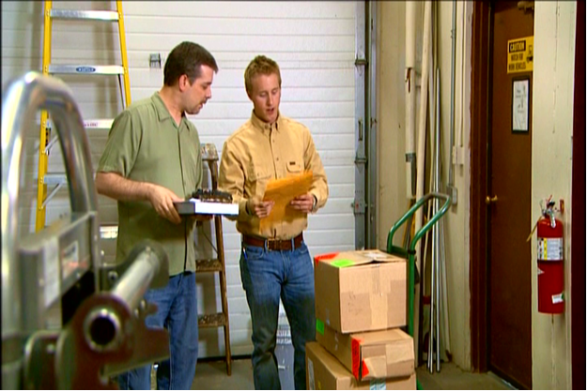
1. Chemical Inventory
When a chemical arrives at your company, hazard information is passed along with it.
This information is added to your company’s chemical inventory.
OSHA requires that each company keep an inventory on all its hazardous chemicals.
Notes:
When a chemical arrives at your workplace, the hazard information is passed along with it so it can be added to your company’s chemical inventory. OSHA requires that each company keep a complete and up-to-date inventory of all its hazardous chemicals, both on-site and off-site.

Slide 10
2. Safety Data Sheets
Explain what you need to know to safely work with a chemical
Must have the GHS-specified 16 section format
Must include certain types of information in each section
Help ensure that employers and employees understand the chemical
Must be readily accessible to employees in the work area during each work shift
Notes:
The safety data sheet explains what you need to know to safely work with a chemical. To be compliant with GHS, all safety data sheets must have the GHS-specified 16 section format and include certain types of information in each section. This standard format helps ensure that all employers and employees understand the chemical, its hazards, and the precautions the user must take to stay safe.
Per OSHA, safety data sheets must readily accessible to you, in your work area, during each work shift.
Trainer Tip: Here, you may want to pass out samples of a GHS-style safety data sheet for a chemical commonly used at your company, and go through each section to review the important information in each one.

Slide 11
3. Labels
Notes:
The safety data sheet is not the only source of information. Each hazardous chemical must be labeled with the chemical name and other vital quick-reference information. The label is not intended to be the sole source of safety and hazard information, but rather serves as an immediate warning to the user.
The HazCom Standard requires that there be six label elements:
- Product identifier or ingredient disclosure;
- Signal word;
- Hazard statement;
- Pictograms;
- Precautionary statement; and
- Supplier identification.
Of these six elements, 4 are “harmonized” in the GHS system based upon the chemical’s hazard class and category – the signal word, hazard statement(s), pictogram, and precautionary statement(s).
The information on the label must be linked back to the safety data sheet and chemical inventory.
Trainer Tip: Pass out samples of a GHS-style label for a chemical that is commonly used at your company, and go over each label element in detail.

Slide 12
Pictograms
Notes:
There are nine pictograms:
- Oxidizers;
- Flammables;
- Explosives;
- Acute toxicity;
- Corrosives;
- Gases under pressure;
- Health hazards;
- Environmental hazards; and
- Health irritant or other harmful effects.
Pictograms are always a black symbol shown on a white background and surrounded by a red, diamond shaped border. These images are used to depict the physical, health or environmental hazards caused by a particular chemical. They are meant to be an immediate, graphic warning.

Slide 13
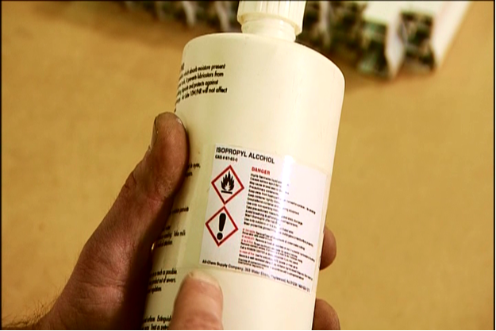
Re-Labeling
Re-labeling can take place when:
Your employer chooses to use an OSHA-approved label in your workplace.
A large quantity of a chemical is broken down into smaller ones to use in different areas.
Notes:
Your employer can choose to re-label chemicals in your workplace with an OSHA-approved label.
Re-labeling might occur when a large quantity of a chemical is broken down into smaller ones, and then distributed to different areas in the company.

Slide 14
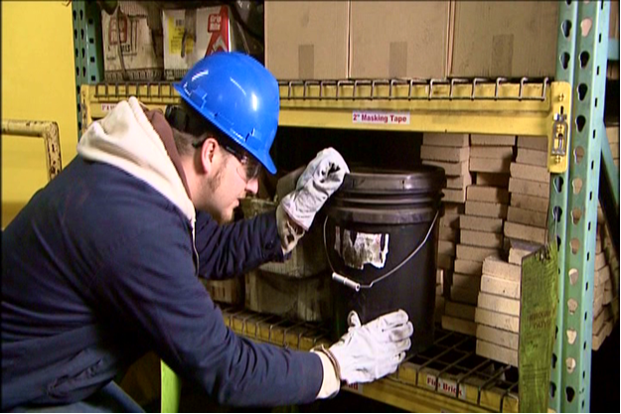
Re-Labeling, continued…
If you ever find a container with no label, or an illegible label, contact your supervisor.
Never use a chemical from an unlabeled container.
Notes:
If you ever find a container without a label, or the label is illegible, contact your supervisor immediately so that a new label can be applied. Whatever you do, don’t use a chemical from an unlabeled container, or a container with an unreadable label!

Slide 15
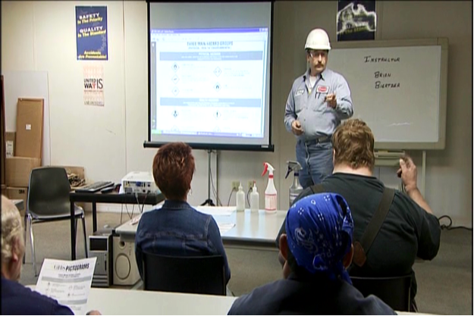
4. Training & Information
Employees must receive training on:
HazCom Standard requirements
Hazard chemical locations
Chemical inventory
Safety data sheets
Labels
Written HazCom program
Specialized chemicals
Notes:
The chemical inventory, safety data sheets and labels are critical when it comes to working safely with hazardous chemicals, but what brings it all together is the training and information your company is required to provide to you.
The HazCom Standard requires that each person who works with hazardous chemicals be trained on:
- HazCom Standard requirements;
- Places where hazardous chemicals are located in your workplace;
- Location and availability of the chemical inventory, safety data sheets and written HazCom program, and how to read GHS-style safety data sheets and labels; and
- The in-house labeling system your company uses, if applicable
In addition, your employer must provide you with specialized training for the specific chemicals you’ll use in your job, as well as symptoms of over-exposure and how to protect yourself from harm.

Slide 16
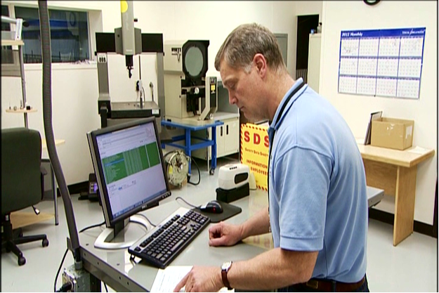
5. Written HazCom Program
Documents, in detail, your employer’s plans for communicating chemical hazards.
You have a right to review the written HazCom program whenever you want.
Notes:
The fifth employer requirement is the written HazCom program. The purpose of the written HazCom program is to document, in detail, your employer’s plans for communicating the hazards involved with using the chemicals in your workplace.
You have the right to review the written HazCom program whenever you want, so you can see what your employer is doing to keep you and your coworkers knowledgeable and safe.

Slide 17
Staying safe
Simple actions you can take to stay safe when working with chemicals:
Remove all jewelry
Use eye and face protection
After using a chemical, wash your hands
Clean and store safety gear properly
Notes:
Here are some simple actions you can take to stay safe when working with or around chemicals:
- Remove all jewelry to avoid skin reactions.
- Use eye and face protection if the chemical can splash in your face.
- When you finish handling a chemical, wash your hands thoroughly.
- Make sure safety gear is clean and properly stored.

Slide 18
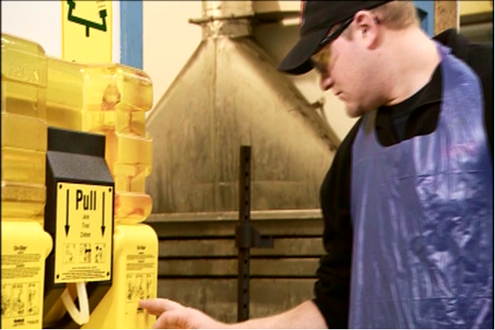
Staying safe, continued…
Other simple actions:
Know where the nearest eyewash station or emergency shower is located
Dispose of hazardous chemicals properly
Know how to deal with spills and leaks
Know how to respond in an emergency
Notes:
Here are some more simple actions you can take to stay safe when working with or around chemicals:
- Know where the nearest eyewash station or emergency shower is located.
- Dispose of hazardous chemicals properly, and never mix chemical wastes unless you know that it’s safe to do so.
- Know your company’s policy for dealing with spills and leaks.
- Know how your employer wants you to respond in an emergency situation.

